Slide 1

Why scale up doesn’t seem to work:
Sources of unpredictability in the European ATM system
Prepared by IFATCA JCHMS Team
Presented by Marc Baumgartner, SESAR and EASA coordinator IFATCA

Slide 2
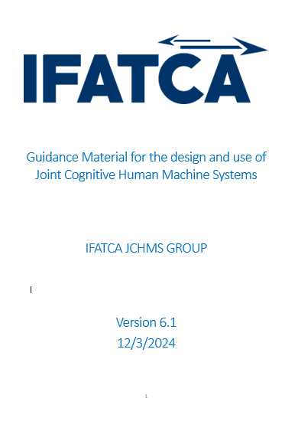

Challenges from the Introduction of Artificial Intelligence in the European Air Traffic Management System
Prepared by IFATCA JCHMS Team

Slide 3
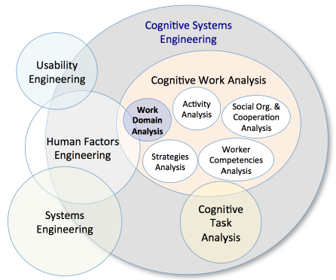


What is the goal of the paper?
In this paper, we present the findings from an attempt to document collectively and coherently the sources of unpredictability in the European ATM system through the lens of Cognitive Systems Engineering paradigm.

Slide 4
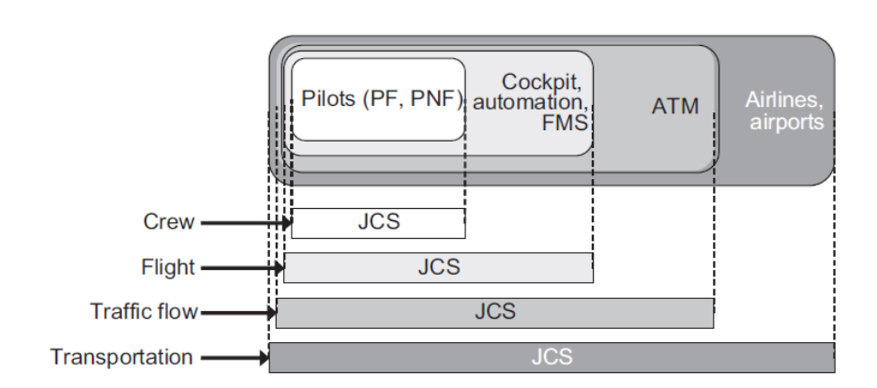
The traffic flow Joint Cognitive System (Hollnagel, 2007)

Slide 5

Methodology
Documentation analysis.
Literature review.
Divergent thinking.
Comparative reasoning,
Operational expertise.
Integrative thinking,
structured interviews with operational controllers ,
participation in group discussions

Slide 6
Findings
Findings

Slide 7
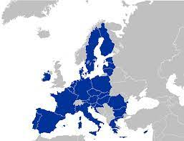

Political / Regulatory - 1
Policy Changes and Regulations: Shifts in political climate can lead to changes in regulations, affecting airspace management and operational priorities. For instance, BREXIT has implications for the UK's participation in the Single European Sky initiative.
International Relations: Tensions or agreements between countries can impact the availability of airspace, forcing reroutes that complicate traffic management.
ICAO:
  Global Standards and Regulations: ICAO develops international civil aviation standards and recommended practices (SARPs). The process of adopting these SARPs into national regulations can vary significantly between countries, leading to discrepancies and uncertainties in global aviation operations.
  Policy Changes: Shifts in ICAO policies or standards, often in response to emerging safety concerns, technological advancements, or environmental issues, can introduce unpredictability as states and operators adjust to new requirements.
EASA:
  Regulatory Changes: EASA's stringent safety and operational regulations govern EU member states and associated countries. Changes or updates in these regulations can require significant adjustments by airlines, manufacturers, and ANSPs, leading to transitional periods of uncertainty.
  Certification Processes: The process of certifying new aircraft, technologies, or operational procedures can be lengthy and complex, affecting the introduction of innovations and operational plans.

Slide 8
Political / Regulatory - 2
EUROCONTROL
  Traffic Management: EUROCONTROL's role in managing air traffic flow across Europe involves coordinating with numerous national ANSPs. Changes in traffic management policies or practices can introduce unpredictability, especially during peak periods or in response to disruptions.
  Technology Implementation: The integration of new technologies or systems (e.g., the Centralised Services initiative, CNS) requires significant coordination and adaptation efforts, leading to periods of adjustment and uncertainty.
SESAR JU
  Innovation and Research: SESAR JU leads the technological and procedural innovation for the Single European Sky initiative. While aiming to modernize European ATM, the implementation phases of new technologies and concepts can lead to operational uncertainties as stakeholders adapt to changes.
  Harmonization Efforts: Efforts to harmonize ATM practices across Europe face challenges due to differing national priorities, existing technologies, and regulatory frameworks, leading to uneven adoption rates and operational inconsistencies.

Slide 9
Political / Regulatory - 3
Common Sources of Unpredictability across Organizations
  Adoption and Implementation Rates: The pace at which new regulations, technologies, and procedures are adopted and implemented can vary widely among countries and operators, leading to unpredictability in operational practices and capabilities.
  Technological Compatibility: Ensuring compatibility and interoperability between new and existing technologies across different jurisdictions and operators presents ongoing challenges.
  Stakeholder Alignment: Achieving consensus among diverse stakeholders (governments, ANSPs, airlines, airports) with varying interests and priorities can be difficult, affecting the predictability of regulatory and operational changes.
  Global vs. Regional Needs: Balancing global standards and initiatives (ICAO) with regional requirements and ambitions (EASA, SESAR, EUROCONTROL) can lead to complexities and uncertainties, especially for operators and ANSPs working across these different regulatory environments.

Slide 10

ANSP / Business - 1
Economic Pressures: Financial constraints can affect the investment in infrastructure and technology upgrades, impacting the efficiency and predictability of air traffic control services.
Technological Integration: The pace at which new technologies are adopted varies across different ANSPs, affecting the overall coherence and predictability of the ATC system in Europe.
Integration and Interoperability Issues
  Diverse Technologies across Borders: Differences in technology and procedures among ANSPs in different countries can complicate cross-border flight operations, affecting efficiency and predictability.
  Standardization and Harmonization: The slow pace of standardization and harmonization of ATM technologies and procedures at the international level can hinder the seamless management of air traffic, especially in congested areas

Slide 11
Technical - 1
Aging Infrastructure: The reliance on outdated technology can limit the capacity and efficiency of ATC operations, leading to delays and unpredictability.
Cybersecurity Threats: Increasing cyber threats pose risks to ATC systems' integrity and reliability, potentially disrupting operations.
System Interoperability: Variations in technical systems and standards across countries and regions can hinder seamless air traffic management, leading to inefficiencies and unpredictability.
Data Quality and Availability
  Incomplete or Inaccurate Data: Forecasts rely heavily on historical data. Inaccuracies, gaps, or inconsistencies in this data can lead to flawed predictions, affecting everything from capacity planning to daily operations.
  Real-time Data Integration: The ability to incorporate real-time data into forecasts can significantly improve accuracy. Limitations in real-time data collection, processing, and integration can hinder this capability, affecting forecast reliability.
Modeling Challenges
  Model Complexity: The complexity of air traffic systems, with numerous interacting variables, makes modeling challenging. Simplifications or assumptions necessary for computational feasibility can compromise forecast accuracy.
  Changing Patterns: Air traffic patterns can evolve due to a myriad of factors, including economic shifts, airline strategies, and geopolitical events. Models that do not account for these dynamic changes can quickly become outdated.

Slide 12
Technical - 2
Forecasting Methodology
  Statistical vs. AI/ML Approaches: Traditional statistical methods may not capture complex nonlinear relationships as effectively as machine learning models, which can adapt to changing patterns but require large datasets and can be opaque.
  Scenario Planning: The reliance on a narrow set of assumptions can limit the effectiveness of forecasts. Broadening scenario planning to include a wider range of potential futures can help, but also introduces complexity.
Technological Disparities
  Diverse ATC Systems: The technological platforms and systems used for ATC operations vary significantly among European countries, leading to challenges in interoperability and data exchange.
  Upgrade and Integration Challenges: Efforts to modernize or harmonize ATC technologies face obstacles due to the different starting points, priorities, and budgets of national authorities.

Slide 13
Technical - 3
Seasonal and Event-driven Variability: Forecasts may not always accurately predict spikes in traffic due to special events (sports events, political summits) or seasonal variations, leading to capacity strain and increased unpredictability.
AI/ML Limitations
  Data Quality and Availability: AI and ML models are only as good as the data they are trained on. Inconsistencies, gaps, or biases in historical data can lead to inaccurate predictions or decision-making supports, affecting operational efficiency and safety.
  Model Transparency and Explainability: Many AI/ML models, especially deep learning algorithms, operate as "black boxes," making it difficult to understand how they derive certain conclusions or recommendations. This lack of transparency can be a significant barrier to their adoption in safety-critical environments like air traffic control.
  Integration with Existing Systems: The integration of AI/ML technologies with existing ATC systems poses technical and operational challenges. Compatibility issues, resistance to change, and the need for comprehensive validation and certification processes can delay the deployment of these technologies, limiting their potential benefits.
  Reliance on Predictive Algorithms: Over-reliance on AI/ML predictions can lead to complacency or a reduction in situational awareness among controllers. Furthermore, unpredictable or "edge case" scenarios may not be well-represented in training data, leading to potential system failures or unexpected behavior under rare conditions.

Slide 14
Operational - 1
Weather Conditions: Adverse weather is a significant source of unpredictability, affecting flight paths, delays, and cancellations.
Traffic Volume: Fluctuations in air traffic volumes, influenced by seasonal peaks, events, or economic factors, challenge capacity management and predictability.
Emergency Situations: Unforeseen events such as emergencies, technical failures, or security threats can disrupt planned operations, introducing delays and rerouting.
Runway Throughput: The number of takeoffs and landings that can be safely accommodated in a given time period is limited. Factors such as runway length, configuration, and surface conditions affect capacity.
Gate and Stand Availability: Limited parking spots and gates for aircraft can cause delays, especially during peak times or when unexpected events cause a surge in traffic.
Ground Handling Services: Inefficiencies in baggage handling, refueling, and aircraft servicing can lead to departures being delayed, impacting the broader air traffic management system.

Slide 15
Operational - 2
Operational Practices
  Airspace Management: Restrictions on airspace use, whether for military activities, space launches, or other reasons, can limit the availability of optimal flight paths, leading to inefficiencies and delays.
  Traffic Flow Management: Inadequate traffic flow management strategies during peak periods or in response to adverse weather conditions can result in suboptimal routing and spacing, increasing unpredictability.
Traffic Density : Europe's airspace is among the most densely used in the world, with a large number of flights within a limited area, leading to significant route optimization challenges.
Complex Airspace Configuration: The European airspace is characterized by a dense network of flight paths, with numerous controlled zones and military areas, further complicating navigation and route planning.
Inefficient Airspace Utilization: Fragmentation leads to suboptimal routing, with flights often taking longer paths to avoid entering different control zones, increasing fuel consumption, flight times, and CO₂ emissions.

Slide 16
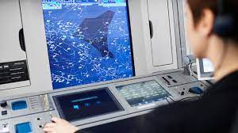
Air Traffic Controllers
Controller Workload: High traffic volumes, complex airspace structures, or emergency situations can lead to controller overload.
Training and Staffing Levels: Insufficient staffing or gaps in controller training can affect the ability of ANSPs to manage air traffic efficiently, leading to delays and increased spacing between aircraft.
Human Performance: The performance of air traffic controllers can be affected by fatigue, stress, or cognitive overload, leading to variability in decision-making and efficiency.
Expertise and Experience: Differences in the training, experience, and expertise of air traffic controllers can impact the handling of complex or unexpected situations, affecting predictability.
Communication: Miscommunications or language barriers between controllers and pilots can lead to misunderstandings and operational inefficiencies, contributing to unpredictability.
Coordination Challenges: The need for extensive coordination across multiple control centers for cross-border flights can lead to delays and increased workload for ATC staff.
Capacity Constraints: Different management practices and capacity limitations across regions can result in congestion and inefficiencies, particularly in high-demand areas or during peak seasons.

Slide 17


The way Forward
What sources of unpredictability can be controlled’?
How can we do this without jeopardizing safety?

Slide 18

Ερωτήσεις;
Questions

